Slide 1


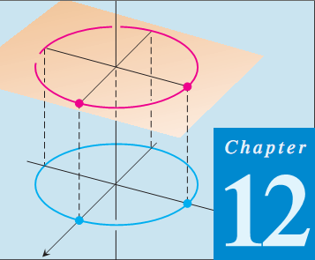
Thomas Calculus 11th
03
Vectors and Geometric of Space
Samuel Lukas

Slide 2
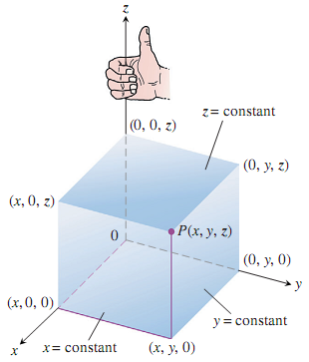
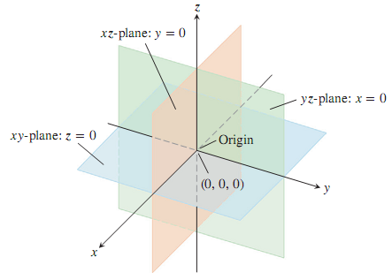
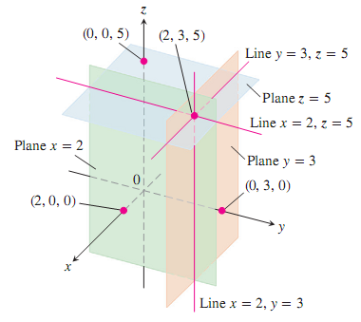
Three Dimensional Coordiante Systems

Slide 3
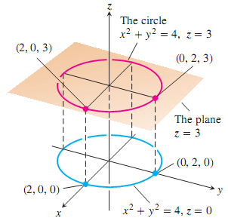


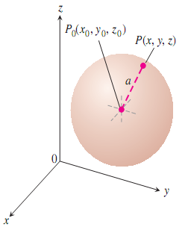

Distance Between Two Points

Slide 4
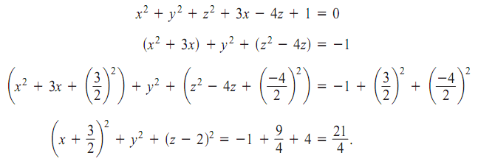
Example

Slide 5

Exercises 1
Describe the given set with a single equation or with a pair of equations
Describe the sets of points in space below
Write inequalities to describe the sets of points below
Find the centers and radii of the spheres

Slide 6

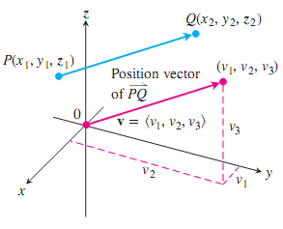


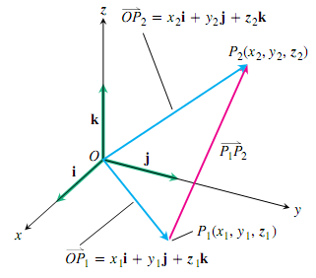
Vectors

Slide 7
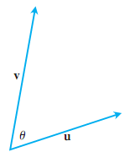



Dot Product

Slide 8
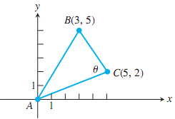
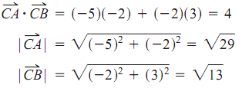

Orthogonal Vectors

Slide 9
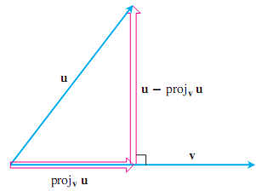
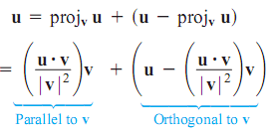




Vector Projection

Slide 10



Exercises 2

Slide 11
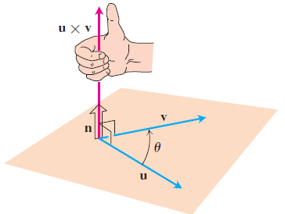

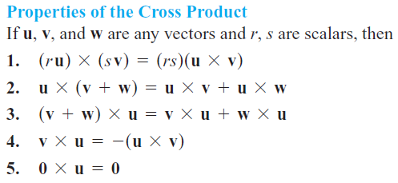
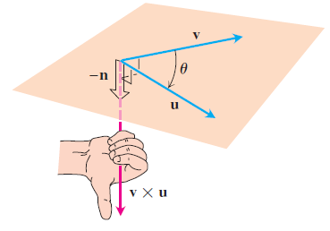

Cross Products

Slide 12


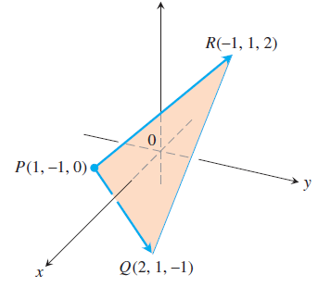



Example

Slide 13
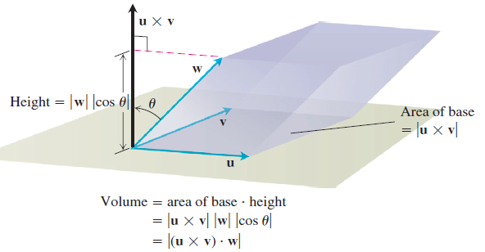
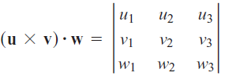


Slide 14

Exercises 3
Find the length and direction (when defined) of
Find the area and a unit vector perpendicular to triangle determined by the points P, Q, and R.
Find the areas of the triangles whose vertices are given

